Slide 1

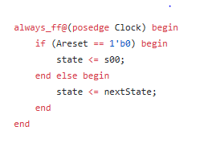
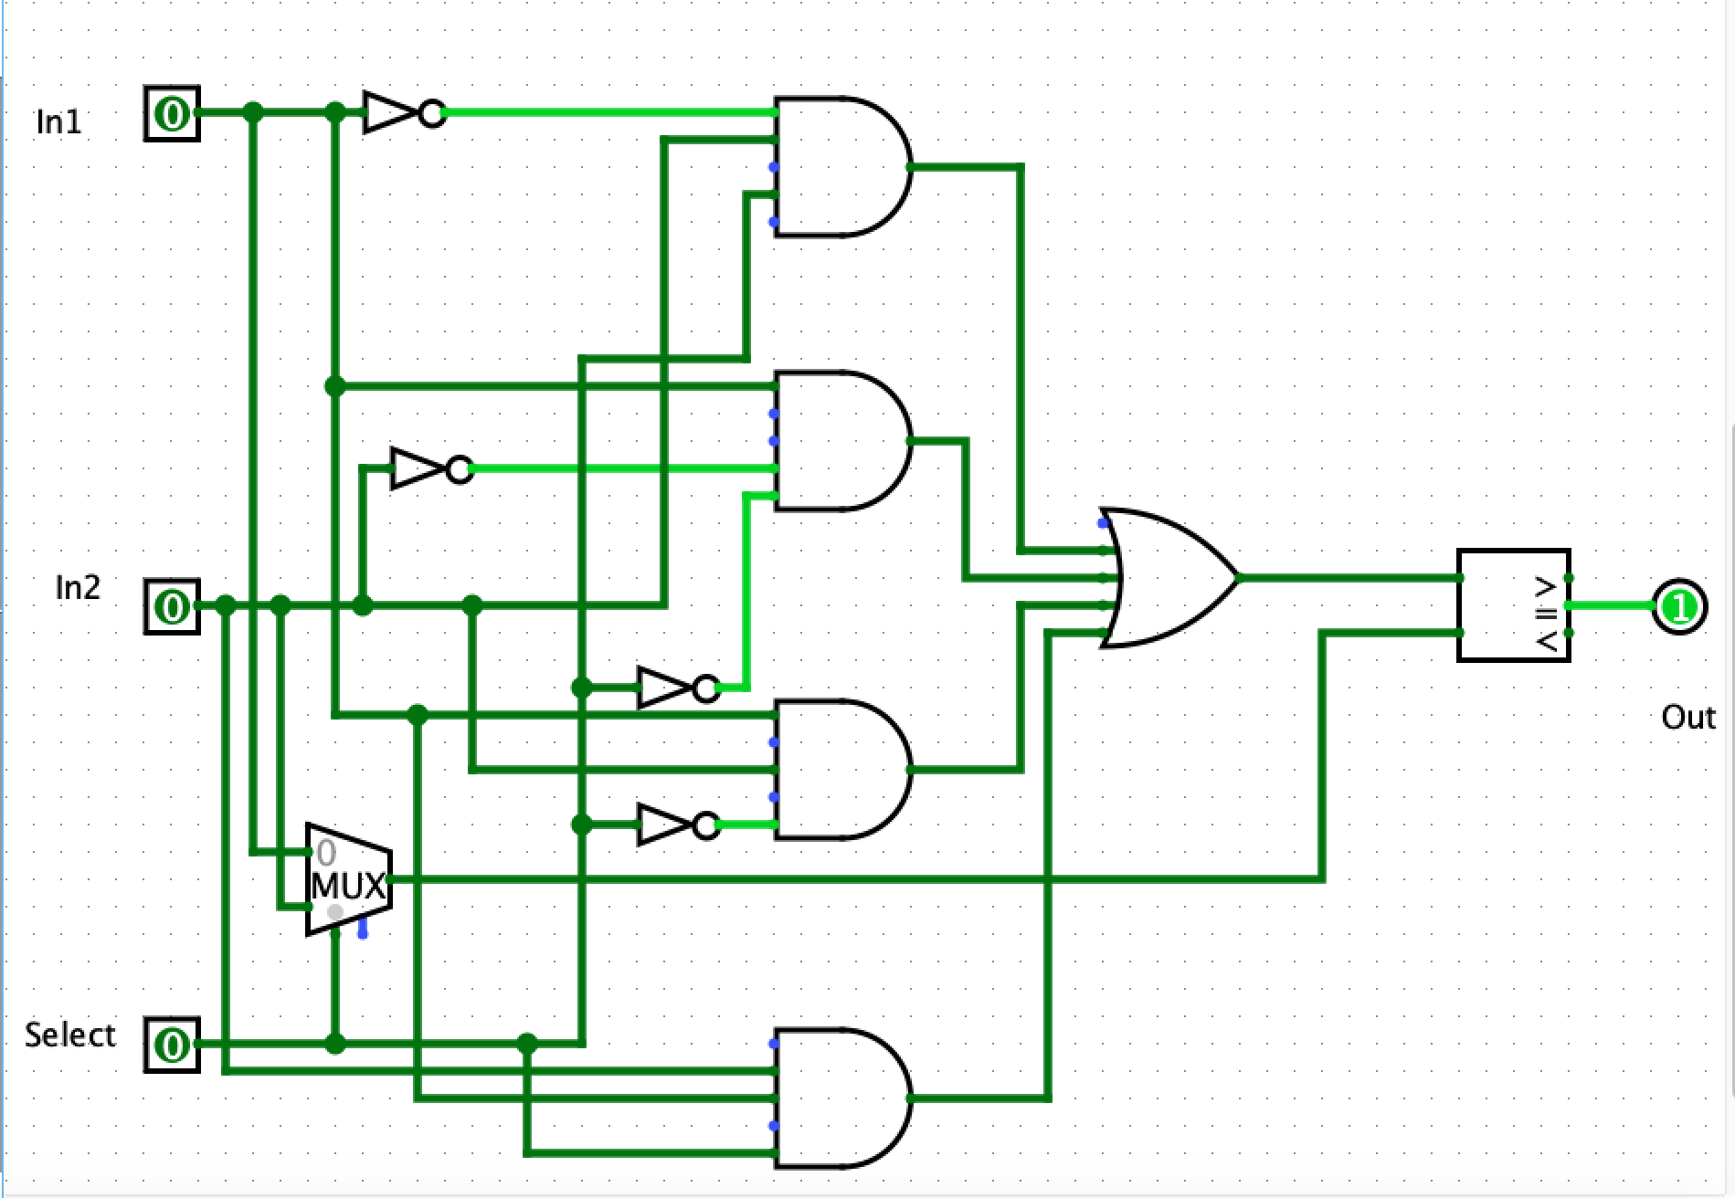
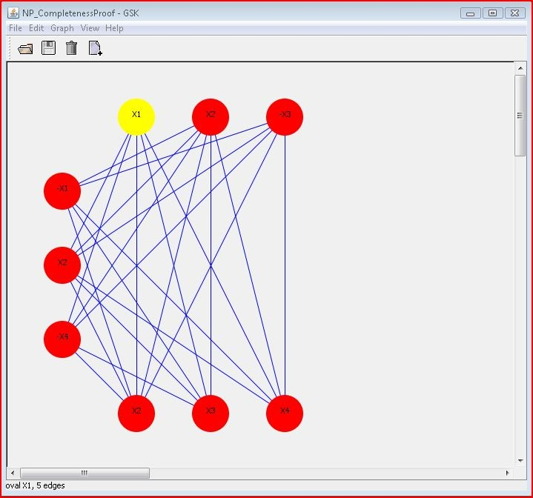
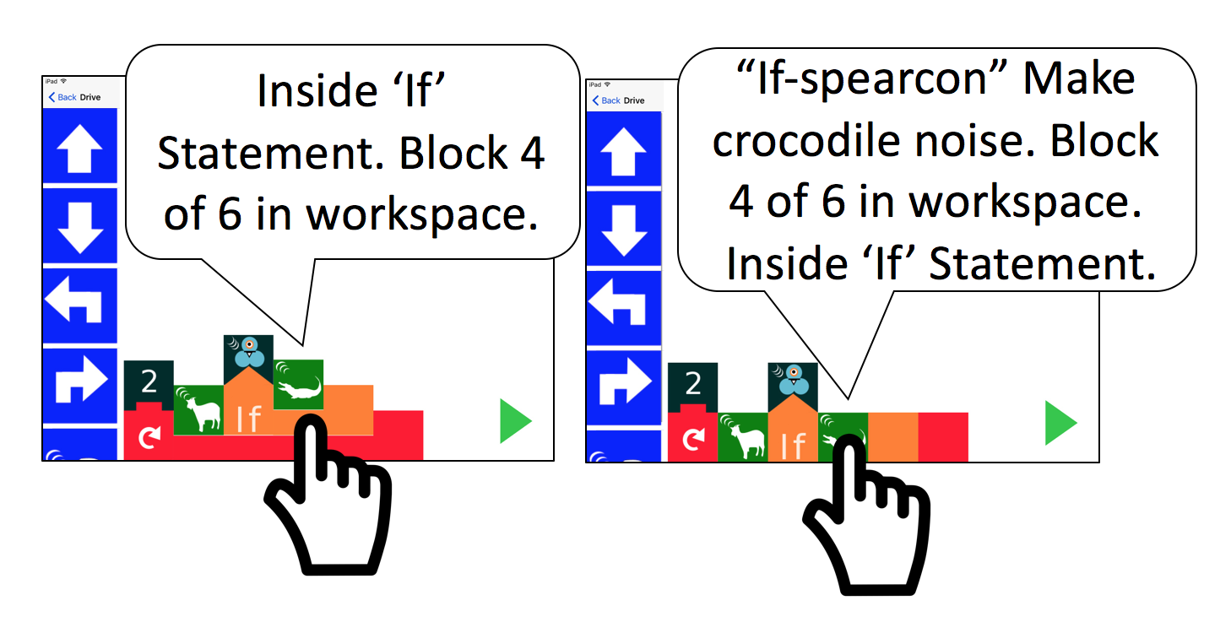
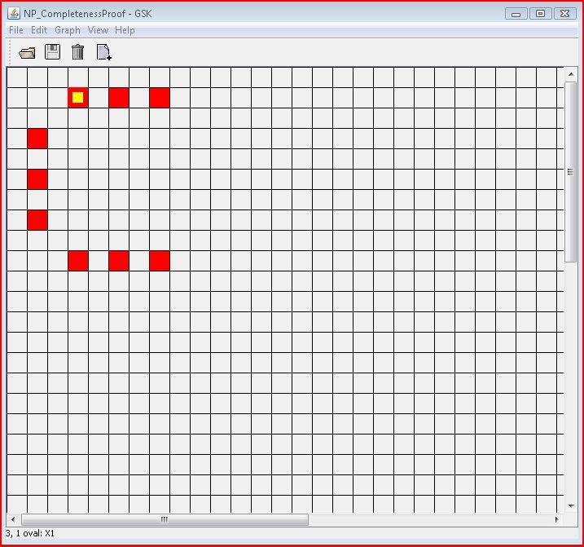

Accessible Tools for Blind Students to Design Digital Circuits
Yitong Li, Mentors: Kyle Rector & Brandon Myers
{yitong-li, kyle-rector, brandon-d-myers}@uiowa.edu
Department of Computer Science
Abstract
Students who are visually impaired face barriers in higher-level computing courses.
A common task is for students to design digital circuits, through writing code or creating schematics through a drag-and-drop interface.
For students with visual impairments, drag-and-drop interfaces are not accessible, forcing them to only use code.
However, exclusively using code is insufficient for learning digital circuit design.
To address these problems, we are reviewing the literature to determine how current programming software is inaccessible and how to develop software that enables students who are visually impaired to create and interact with schematics.
Barriers That Blind Programmers Face
Textual Navigation
Programmers and students usually use visual aids called
Integrated Development Environments (IDE) to help write
programs, but blind programmers might not get as much
information as their sighted counterparts. (StructJumper)
Context switching between lines of code or debugging
might be inefficient for blind students. (StructJumper)
Screen reader cannot help generate a general picture of
the code structure for blind programmers. (StructJumper)
Complicated syntax of certain programming language.
(A Comparison of Program Strategies)
Spatial/Graphical Navigation
Screen reader cannot “read” graphs. (Blocks4All)
Drag-and-drop programming is highly visual; therefore
unavailable to blind learners. (Blocks4All)
Some important graphs, often as node-link diagrams, are
widely used in Computer Science, but they are often
inaccessible to students and professionals. (GSK)
https://github.uiowa.edu/bdmyers/cs4980-public/blob/master/Lab3/fsm/OnesDetector.sv
CS:2630 Computer Organization
Existing Solutions
Textual programming needs spatial navigation, too!
Existing Solutions
Textual Navigation
StructJumper:
A plugin to existing programming tool that creates hierarchical tree to help blind programmers navigate the code.
It is compatible with one of the popular programming visual aids called Eclipse.
It makes both navigating the code and understanding where they are within the code easier for blind programmers
Complicated textual code will eventually converted to a hierarchical structure to make navigation and debugging easier.
Quorum Programming Language:
A programming language designed to help people with different disabilities.
It has tutorial for novice programmers.
It uses screen reader in order to create an audio programming language environment.
The developers of this language simplified the syntax to make it more accessible for blind students.
Spatial/Graphical Navigation
Blocks4All:
A drag-and-drop programming language primarily
designed for children.
It simplifies the syntax of programming languages.
Universal designs means it is accessible for both
sighted and blind children.
It is based on touch screen, which can be explored
using speech and sound and compatible to screen
reader.
Graph Sketching (GSK):
It has two views – Connection View and Grid View
The connection view uses graph – a data structure.
Its connection view is accessible for both sighted
and blind programmers.
The grid view adopts chessboard idea.
Both connection and grid view can guide blind
people to add/remove/edit a node or a
connection.
Its properties windows can help turn the graph
into text to make it readable for screen reader.
Connection view
Blocks4All
What sighted people see
Grid view
StructJumper: A Tool to Help Blind Programmers Navigate and Understand the Structure of Code. 2013
https://milnel2.github.io/
What blind programmers navigate aurally
StructJumper: A Tool to Help Blind Programmers Navigate and Understand the Structure of Code. 2013
GSK: universally accessible graph sketching. 2013
What’s Next?
Solutions above have some shortcomings when it comes to circuits design:
Hierarchical trees usually have limited amount of layers; therefore when dealing with large chunk of code, StructJumper might be inefficient.
Blocks4All might not be helpful when it comes to complex circuit design, since it is designed for children.
GSK treats nodes and connections equally, but in circuit design, wires and endpoints/nodes might have different functions and should not be treated equally.
We plan to focus on improving the accessibility of spatial/graphical navigation, because:
Programmers tend to come up with schematics to help them structure their textual code.
In circuit design, textual programming like Verilog also has outputs in graphical form.
Graphical programming tends to be easier for beginners to understand.
We choose Logisim, a digital circuits design language, as our primary language to modify.
We must make Logisim compatible with screen readers.
We plan to adopt some of the ideas of GSK, specifically the chessboard idea from the grid view.
We must modify GSK to distinguish different types of connections and nodes.
In logic circuits we need a different type of node for each component (e.g., AND, OR, NOT) .
Since each port of a component has a specific purpose, a node’s connections are not interchangeable and so connections must be named or ordered.
References
Ameer Armaly, Paige Rodeghero, and Collin McMillan. 2018. A comparison of program comprehension strategies by blind and sighted programmers. In Proceedings of the 40th International Conference on Software Engineering (ICSE '18). ACM, New York, NY, USA, 788-788. DOI: https://doi.org/10.1145/3180155.3182544
Catherine M. Baker, Lauren R. Milne, and Richard E. Ladner. 2015. StructJumper: A Tool to Help Blind Programmers Navigate and Understand the Structure of Code. In Proceedings of the 33rd Annual ACM Conference on Human Factors in Computing Systems (CHI '15). ACM, New York, NY, USA, 3043-3052. DOI: https://doi.org/10.1145/2702123.2702589
Lauren R. Milne and Richard E. Ladner. 2018. Blocks4All: Overcoming Accessibility Barriers to Blocks Programming for Children with Visual Impairments. In Proceedings of the 2018 CHI Conference on Human Factors in Computing Systems (CHI '18). ACM, New York, NY, USA, Paper 69, 10 pages. DOI: https://doi.org/10.1145/3173574.3173643
Suzanne P. Balik, Sean P. Mealin, Matthias F. Stallmann, and Robert D. Rodman. 2013. GSK: universally accessible graph sketching. In Proceeding of the 44th ACM technical symposium on Computer science education (SIGCSE '13). ACM, New York, NY, USA, 221-226. DOI: https://doi.org/10.1145/2445196.2445266
Quorum: https://quorumlanguage.com/
Acknowledgement
This research is supported by ICRU.
Special thanks to Professors Kyle Rector and Bandon Myers for the support, advice, and help.
Special thanks to Dr. Catherine Baker for the helpful suggestions on the research.

